Slide 1


Positive Thinker
Creative Entrepreneur
Independent Learner
Reflective Learner
Responsible Citizen
Team Worker
REFLECTIONS
Enterprise Skills
Which ones are you using?
EXAMPLES
1)
2)
x
x
x
x
Object
x
x
Object
Image
x
x
x
x
x
x
x
x
Image
x
x
Reflect the shape in the mirror line.
Reflect the shape in the mirror line.
Notes:
1

Slide 2
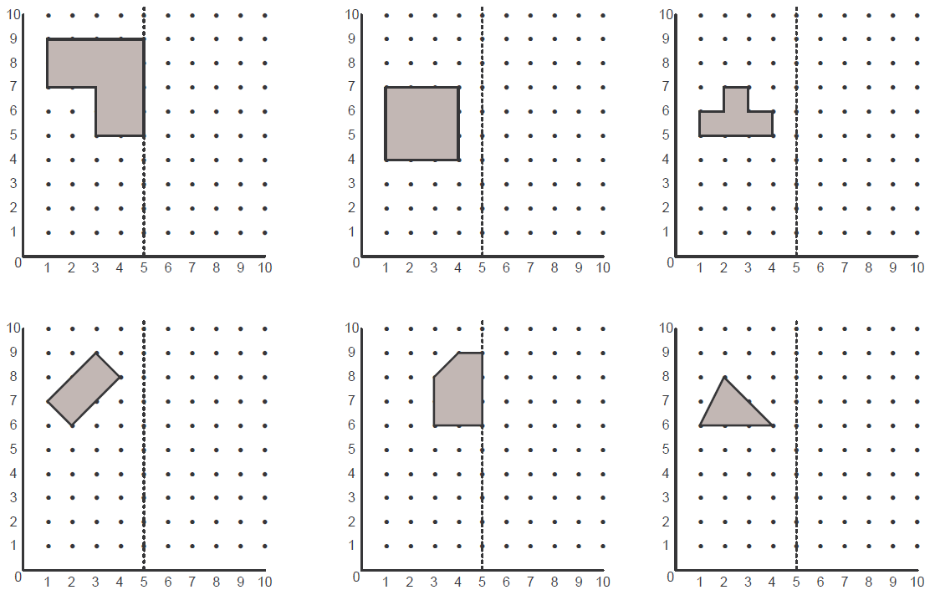
Positive Thinker
Creative Entrepreneur
Independent Learner
Reflective Learner
Responsible Citizen
Team Worker
REFLECTIONS
Enterprise Skills
Which ones are you using?
TASK 1 (LEVEL 4)
Reflect the shapes in the mirror lines given below:
Notes:
2

Slide 3
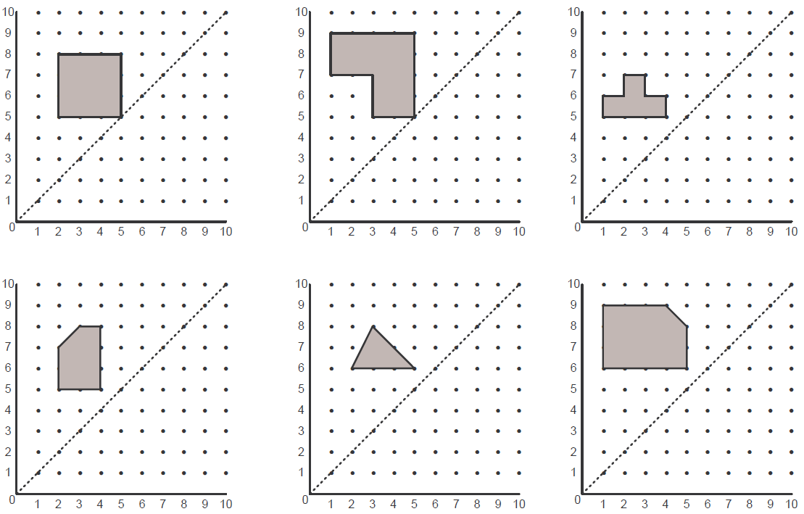
Positive Thinker
Creative Entrepreneur
Independent Learner
Reflective Learner
Responsible Citizen
Team Worker
REFLECTIONS
Enterprise Skills
Which ones are you using?
TASK 2 (LEVEL 4)
Reflect the shapes in the mirror lines given below:
Notes:
3

Slide 4
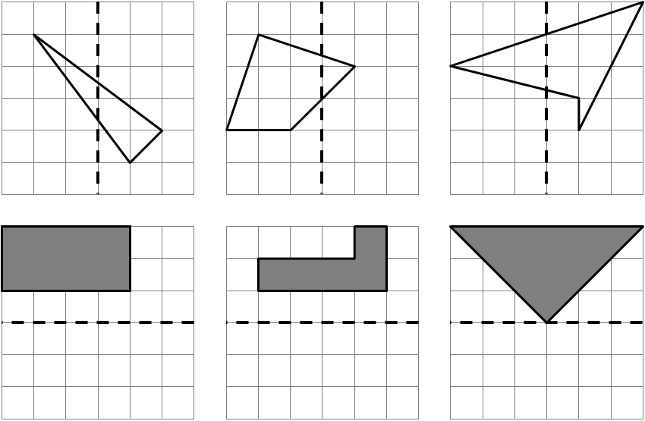
Positive Thinker
Creative Entrepreneur
Independent Learner
Reflective Learner
Responsible Citizen
Team Worker
REFLECTIONS
Enterprise Skills
Which ones are you using?
TASK 3 (LEVEL 4)
Reflect the shapes in the mirror lines given below:
Notes:
4

Slide 5
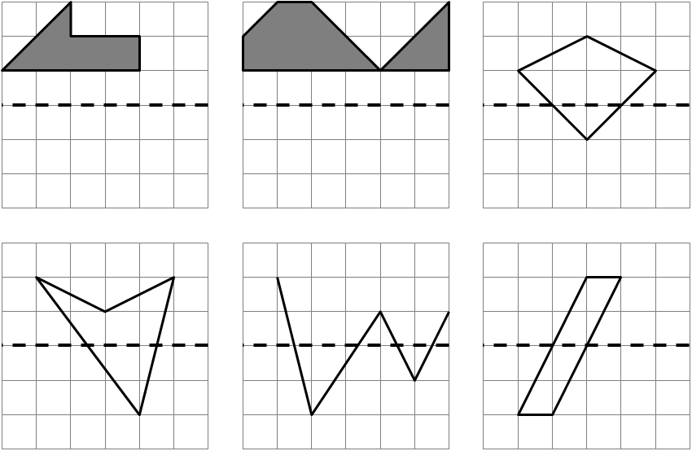
Positive Thinker
Creative Entrepreneur
Independent Learner
Reflective Learner
Responsible Citizen
Team Worker
REFLECTIONS
Enterprise Skills
Which ones are you using?
TASK 4 (LEVEL 4)
Reflect the shapes in the mirror lines given below:
Notes:
5

Slide 6
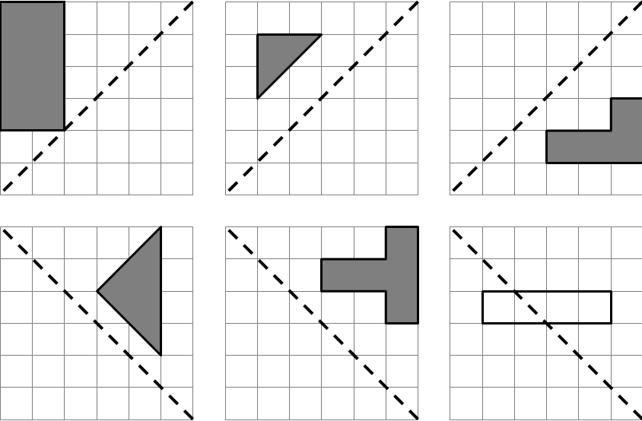
Positive Thinker
Creative Entrepreneur
Independent Learner
Reflective Learner
Responsible Citizen
Team Worker
REFLECTIONS
Enterprise Skills
Which ones are you using?
TASK 5 (LEVEL 4)
Reflect the shapes in the mirror lines given below:
Notes:
6

Slide 7
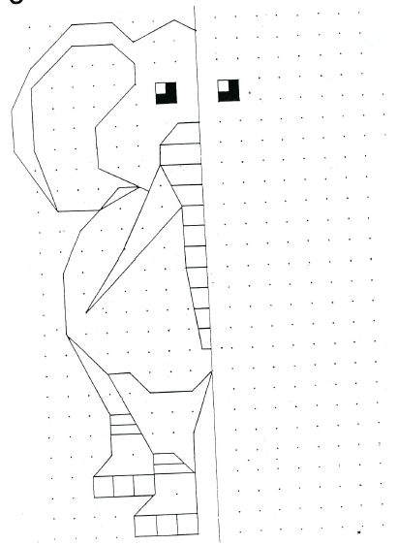
Positive Thinker
Creative Entrepreneur
Independent Learner
Reflective Learner
Responsible Citizen
Team Worker
REFLECTIONS
Enterprise Skills
Which ones are you using?
TASK 6 (LEVEL 4)
Notes:
7

Slide 8
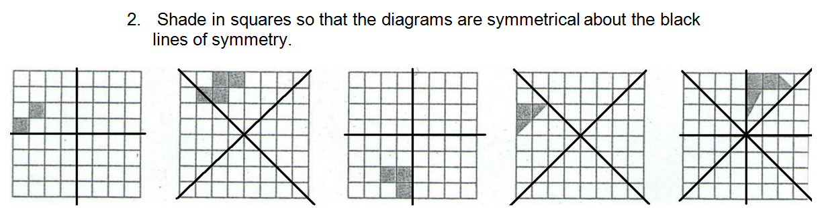
Positive Thinker
Creative Entrepreneur
Independent Learner
Reflective Learner
Responsible Citizen
Team Worker
REFLECTIONS
Enterprise Skills
Which ones are you using?
EXTENSION 1 (LEVEL 5)
Reflect the shapes in the mirror lines given below:
\
\
Notes:
8

Slide 9
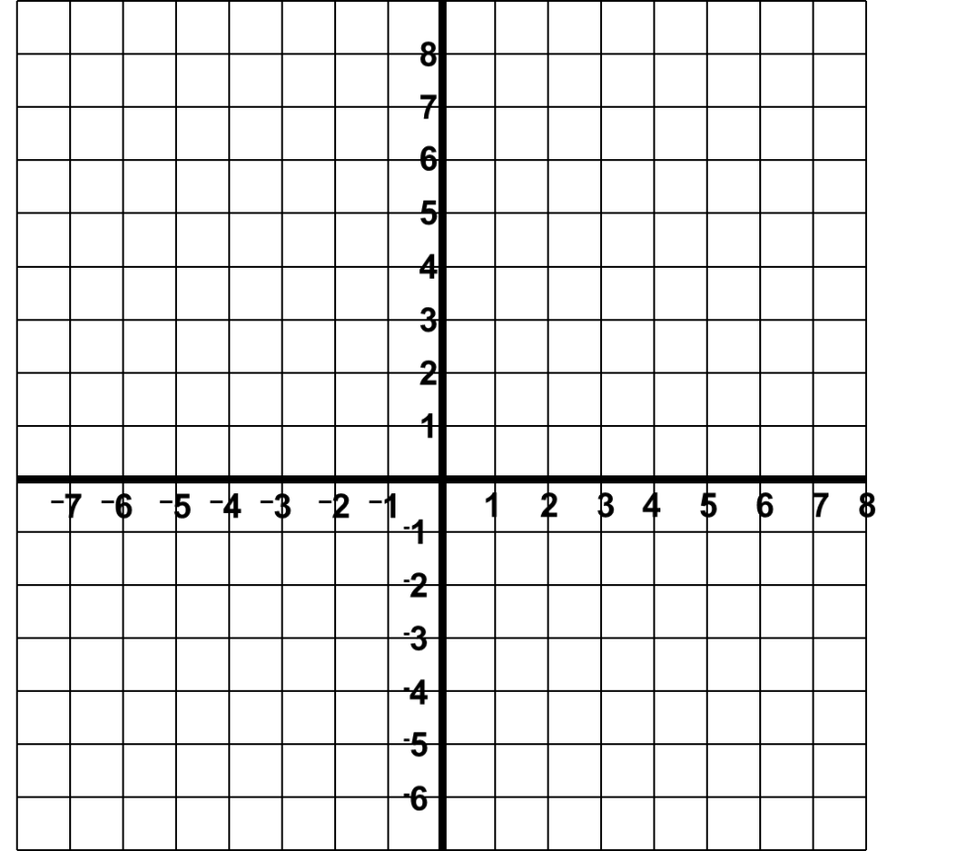
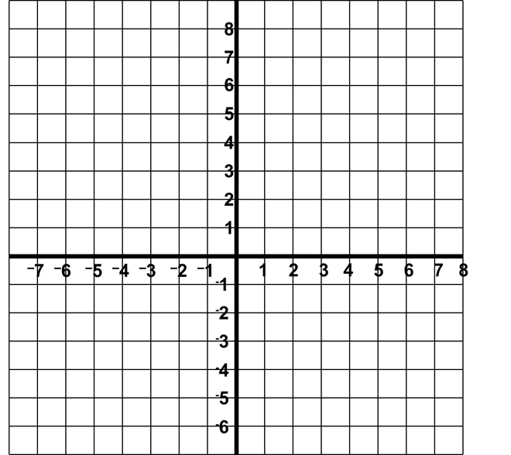
Positive Thinker
Creative Entrepreneur
Independent Learner
Reflective Learner
Responsible Citizen
Team Worker
REFLECTIONS
Enterprise Skills
Which ones are you using?
EXAMPLES
x = -1
y = 2
3)
y
4)
x
x
y
x
x
x
x
x
x
x
x
x
x
x
x
x
x
x
x
x
x
x
x
x
x
x
x
x
x
x
x
x
x
x
x
x
x
x
x
Reflect the shape in the line x = -1
Reflect the shape in the line y = 2
Notes:
9

Slide 10
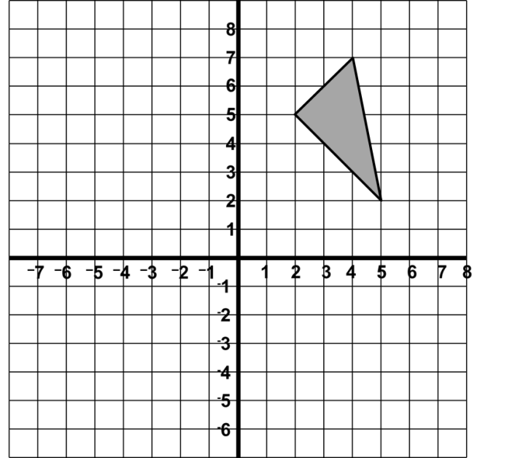
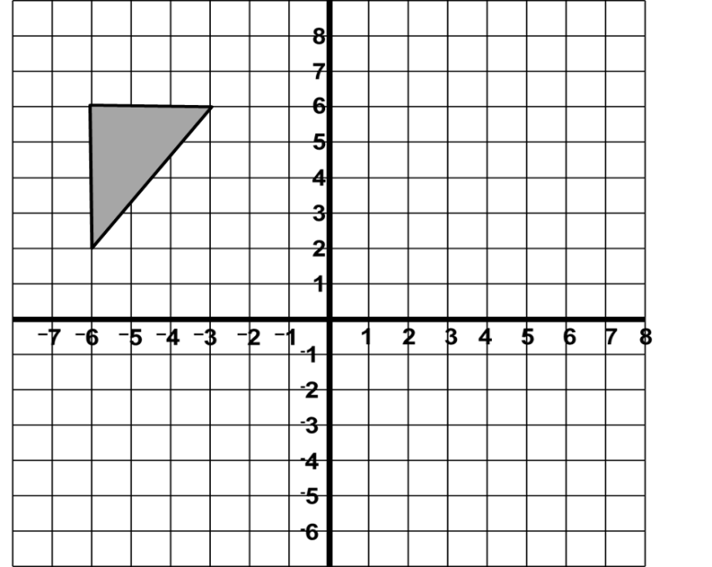
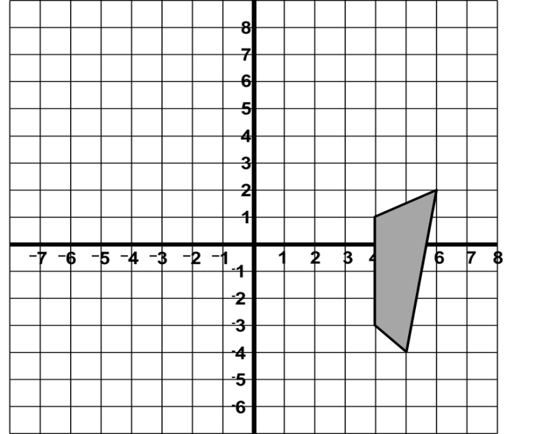
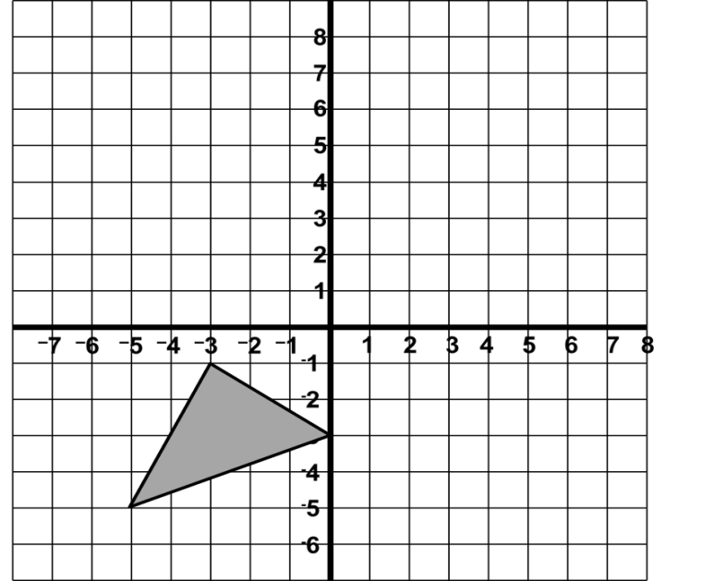
Positive Thinker
Creative Entrepreneur
Independent Learner
Reflective Learner
Responsible Citizen
Team Worker
REFLECTIONS
Enterprise Skills
Which ones are you using?
TASK 7 (LEVEL 5)
x = -1
y = 1
1)
y
2)
y
x
x
Reflect in the line x = -1
Reflect in the line y = 1
3)
x = 2
4)
y
y
y = -1
x
x
Reflect in the line x = 2
Reflect in the line y = -1
Notes:
10

Slide 11
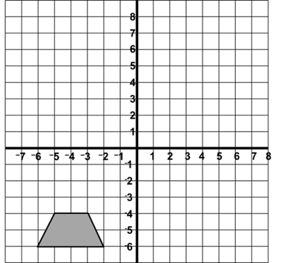
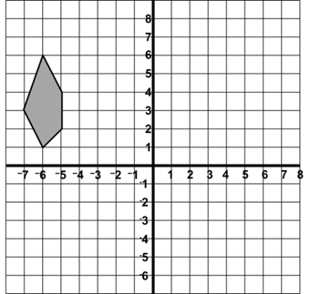
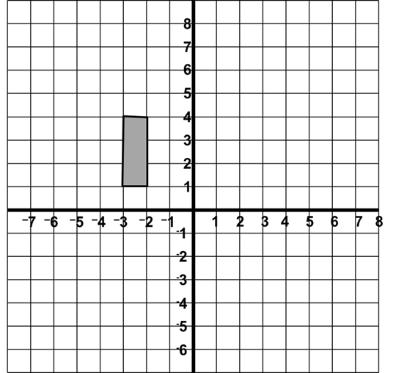
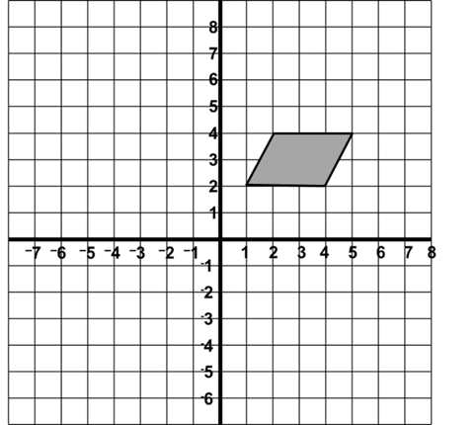
Positive Thinker
Creative Entrepreneur
Independent Learner
Reflective Learner
Responsible Citizen
Team Worker
REFLECTIONS
Enterprise Skills
Which ones are you using?
TASK 8 (LEVEL 5)
1)
y = 0
2)
y
x = 0
y
x
x
Reflect in the line y = 0
Reflect in the line x = 0
y = x
y = -x
3)
y
4)
y
x
x
Reflect in the line y = x
Reflect in the line y = -x
Notes:
11

Slide 12
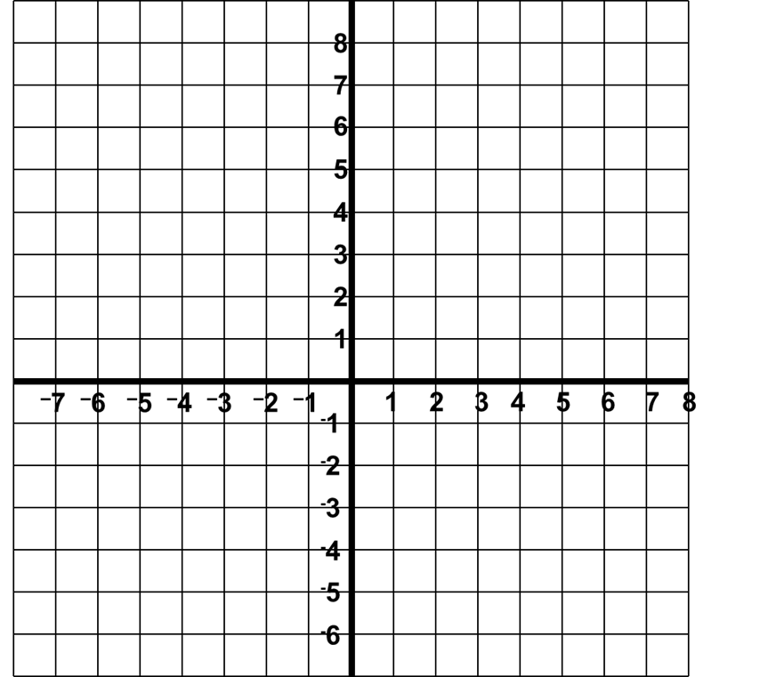
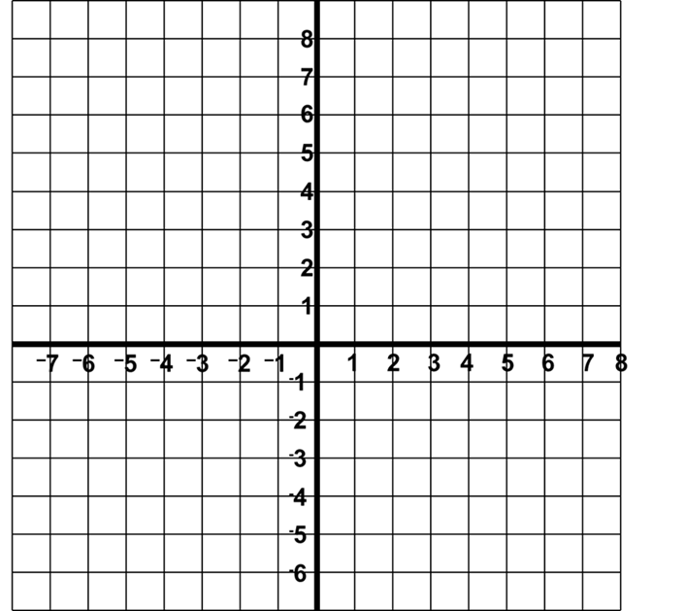
Positive Thinker
Creative Entrepreneur
Independent Learner
Reflective Learner
Responsible Citizen
Team Worker
REFLECTIONS
Enterprise Skills
Which ones are you using?
EXTENSION 2 (LEVEL 5)
1)
Reflect the shape made by the co-ordinates (1,-1), (4,0), (4,-4) in the
x-axis.
2)
Reflect the shape made by the co-ordinates (-3,-5), (-4,0), (-2,-1), (0,-4) in y = -1.
y
y
x-axis
y = -1
x
x
x
x
x
x
x
x
x
Notes:
12

Slide 13
Positive Thinker
Creative Entrepreneur
Independent Learner
Reflective Learner
Responsible Citizen
Team Worker
REFLECTIONS
Enterprise Skills
Which ones are you using?
EXTENSION 2 (LEVEL 5)
3)
Reflect the shape made by the co-ordinates (2,2), (2,5), (3,2) in the
line x = 3.
4)
Reflect the shape made by the co-ordinates (-3,-1), (-3,2), (-1,3), (1,1) in the line x = -1.
y
x = 3
y
x = -1
x
x
x
x
x
x
x
x
x
Notes:
13

Slide 14
Positive Thinker
Creative Entrepreneur
Independent Learner
Reflective Learner
Responsible Citizen
Team Worker
REFLECTIONS
Enterprise Skills
Which ones are you using?
EXAMPLES
y = 3
5)
y
6)
y
y = x
A
A
B
x
x
B
Describe the transformation that maps A to B
Describe the transformation that maps A to B
A reflection in the line y = 3
A reflection in the line y = x
Notes:
14

Slide 15
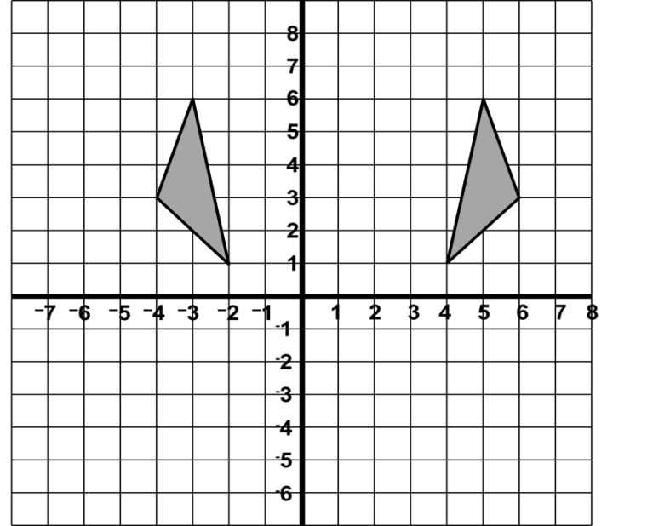
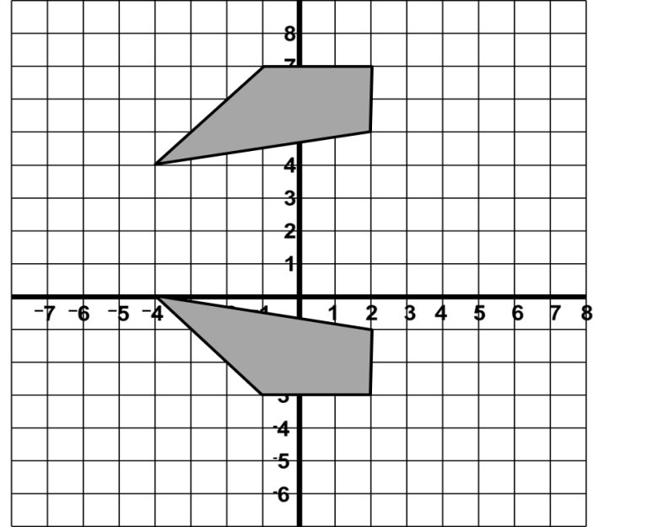
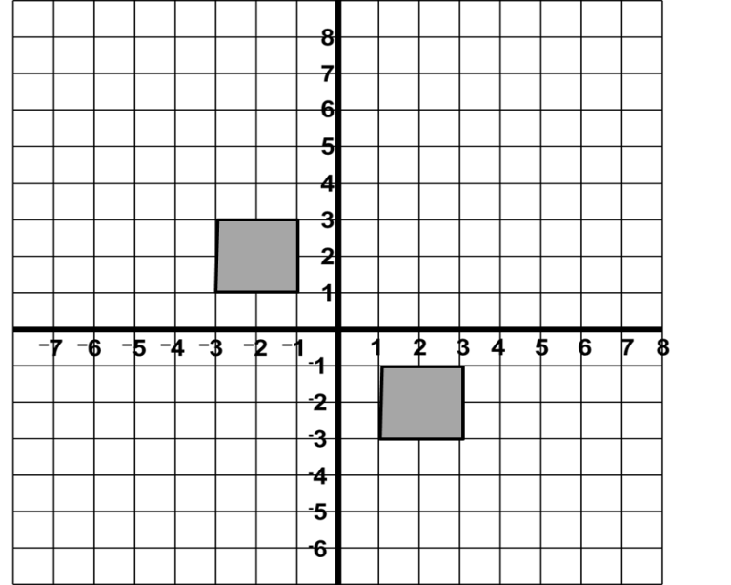
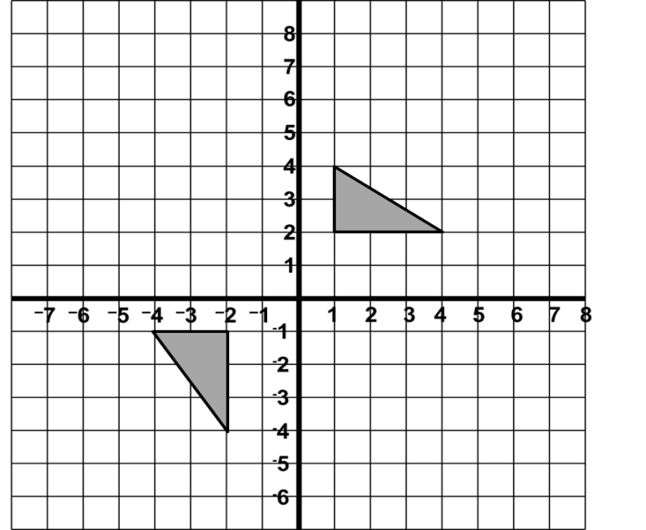
Positive Thinker
Creative Entrepreneur
Independent Learner
Reflective Learner
Responsible Citizen
Team Worker
REFLECTIONS
Enterprise Skills
Which ones are you using?
TASK 9 (LEVEL 6)
1)
y
x = 1
2)
y
y = 2
Describe the transformation
Describe the transformation
x
x
Reflection in the line x = 1
Reflection in the line y = 2
y = x
y = -x
3)
y
4)
y
Describe the transformation
Describe the transformation
x
x
Reflection in the line y = x
Reflection in the line y = -x
Notes:
15

Slide 16
Positive Thinker
Creative Entrepreneur
Independent Learner
Reflective Learner
Responsible Citizen
Team Worker
REFLECTIONS
Enterprise Skills
Which ones are you using?
EXTENSION 3 (LEVEL 5)
1)
Draw a grid running from -6 to +6 in the y direction, and -10 to 10 in the x direction. Plot the following shapes on your grid, joining up the points in order to spell a word.
Shape A: (0,1), (0,3), (0,2), (1,2), (1,3), (1,1)
Shape B: (3,1), (2,1), (2,2), (3,2), (2,2), (2,3), (3,3)
Shape C: (4,3), (4,1), (5,1)
Shape D: (6,3), (6,1), (7,1)
Shape E: (8,1), (8,3), (9,3), (9,1), (8,1)
Draw a line from (0, -1) to (10, -1). Use this as a mirror line and reflect all of the message. What do you notice about the letters?
Draw a line from (0,-6) to (0,6). Use this as a mirror line to reflect both the messages again. What do you notice about the letters?
Plot your name on a set of axis and reflect it using the same lines as above.
What happens if you reflect your name in the same line twice?
Notes:
16

Slide 17
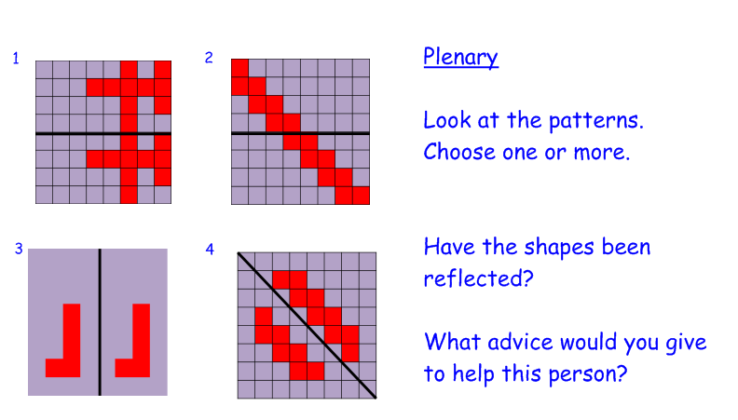
Positive Thinker
Creative Entrepreneur
Independent Learner
Reflective Learner
Responsible Citizen
Team Worker
REFLECTIONS
Enterprise Skills
Which ones are you using?
MINI-PLENARY – ASSESSING UNDERSTANDING
A student has reflected the patterns as shown below. Are the reflections correct and what advice would you give them to help them?
Notes:
17

Slide 18

Positive Thinker
Creative Entrepreneur
Independent Learner
Reflective Learner
Responsible Citizen
Team Worker
DISCOVERY
Enterprise Skills
Which ones are you using?
LINK BACK TO OBJECTIVES
Accurately reflect objects in different mirror lines.
What level are we working at?
Notes:
18

Slide 19




















Positive Thinker
Creative Entrepreneur
Independent Learner
Reflective Learner
Responsible Citizen
Team Worker
REFLECTIONS
Enterprise Skills
Which ones are you using?
PLENARY ACTIVITY
Which letters of these road signs have lines of symmetry?
Notes:
19

Slide 20


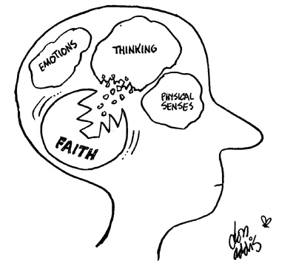

Positive Thinker
Creative Entrepreneur
Independent Learner
Reflective Learner
Responsible Citizen
Team Worker
SELF ASSESSMENT
Enterprise Skills
Which ones are you using?
What have you learnt?
Draw your brain
In your brain, write or draw everything you can remember about reflecting objects in different mirror lines. It can be a skill or a reflection, or something else that might be prominent in your brain.
Where are we in our journey?
What level are we working at?

Slide 21



Positive Thinker
Creative Entrepreneur
Independent Learner
Reflective Learner
Responsible Citizen
Team Worker
SELF ASSESSMENT
Enterprise Skills
Which ones are you using?
Plenary Activity
How well do you understand the task?
.
I don’t understand
I nearly understand
I fully understand

Slide 22
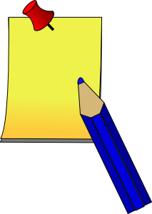


Positive Thinker
Creative Entrepreneur
Independent Learner
Reflective Learner
Responsible Citizen
Team Worker
SELF ASSESSMENT
Enterprise Skills
Which ones are you using?
Plenary Activity
WWW (What Went Well)
EBI (Even Better If)
On your post it notes…
Think about how you can improve your work.

Slide 23
TASK 1 (LEVEL 4)
Reflect the shapes in the mirror lines given below:
Notes:
23

Slide 24
TASK 2 (LEVEL 4)
Reflect the shapes in the mirror lines given below:
Notes:
24

Slide 25
Positive Thinker
Creative Entrepreneur
Independent Learner
Reflective Learner
Responsible Citizen
Team Worker
REFLECTIONS
Enterprise Skills
Which ones are you using?
TASK 3 (LEVEL 4)
Reflect the shapes in the mirror lines given below:
Notes:
25

Slide 26
Positive Thinker
Creative Entrepreneur
Independent Learner
Reflective Learner
Responsible Citizen
Team Worker
REFLECTIONS
Enterprise Skills
Which ones are you using?
TASK 4 (LEVEL 4)
Reflect the shapes in the mirror lines given below:
Notes:
26

Slide 27
Positive Thinker
Creative Entrepreneur
Independent Learner
Reflective Learner
Responsible Citizen
Team Worker
REFLECTIONS
Enterprise Skills
Which ones are you using?
TASK 5 (LEVEL 4)
Reflect the shapes in the mirror lines given below:
Notes:
27

Slide 28
TASK 6 (LEVEL 4)
Notes:
28

Slide 29
Positive Thinker
Creative Entrepreneur
Independent Learner
Reflective Learner
Responsible Citizen
Team Worker
REFLECTIONS
Enterprise Skills
Which ones are you using?
TASK 7 (LEVEL 5)
1)
y
2)
y
x
x
Reflect in the line x = -1
Reflect in the line y = 1
3)
y
4)
y
x
x
Reflect in the line x = 2
Reflect in the line y = -1
Notes:
29

Slide 30
Positive Thinker
Creative Entrepreneur
Independent Learner
Reflective Learner
Responsible Citizen
Team Worker
REFLECTIONS
Enterprise Skills
Which ones are you using?
TASK 8 (LEVEL 5)
1)
y
2)
y
x
x
Reflect in the line y = 0
Reflect in the line x = 0
3)
y
4)
y
x
x
Reflect in the line y = x
Reflect in the line y = -x
Notes:
30

Slide 31
Positive Thinker
Creative Entrepreneur
Independent Learner
Reflective Learner
Responsible Citizen
Team Worker
REFLECTIONS
Enterprise Skills
Which ones are you using?
EXTENSION 1 (LEVEL 5)
Reflect the shapes in the mirror lines given below:
Notes:
31

